Slide 1
Introducing Agent Based Systems
Prabhu Krishnamoorthy

Slide 2


Do you have what it takes to create the ultimate AI agent? How to train your Dragon Agents for Business Apps

Slide 3









A sneak peek - Multi-Agent Systems are the Building Blocks of Future Enterprise
From
To
No complex reasoning, limited interaction, knowledge base dependent, cannot perform actions or use tools
Autonomous Human-augmented decisioning & reasoning, can take actions & use tools, adaptable, dynamic interaction, can generate novel solutions
Agentification
By 2028, one-third of interactions with Gen AI services will use action models & autonomous agents for task completion
AI agents represent the next iteration of AI: not just analyzing trends, and making predictions, but making decisions and acting on them
We are seeing an evolution from off-the-shelf assistants that support knowledge discovery & content generation to custom AI agents to execute complex workflows
AI agents are evolving from passive chatbots to proactive, autonomous systems capable of adapting to their environments and taking independent actions
Notes:
https://www.gartner.com/en/newsroom/press-releases/2024-03-11-gartner-predicts-one-third-of-interactions-with-genai-services-will-use-action-models-and-autonomous-agents-for-task-completion-by-2028#:~:text=By%202028%2C%20one%2Dthird%20of,processes%20based%20on%20human%20intent.
https://www.forrester.com/blogs/the-state-of-ai-agents-lots-of-potential-and-confusion/
https://blogs.microsoft.com/blog/2024/11/12/idcs-2024-ai-opportunity-study-top-five-ai-trends-to-watch/#:~:text=%E2%80%9CWe%20are%20at%20an%20inflection,%2C%20GVP%2FGM%2C%20AI%20and
https://www.hfsresearch.com/research/agentic-ai-shatter-workforces-and-economies/

Slide 4


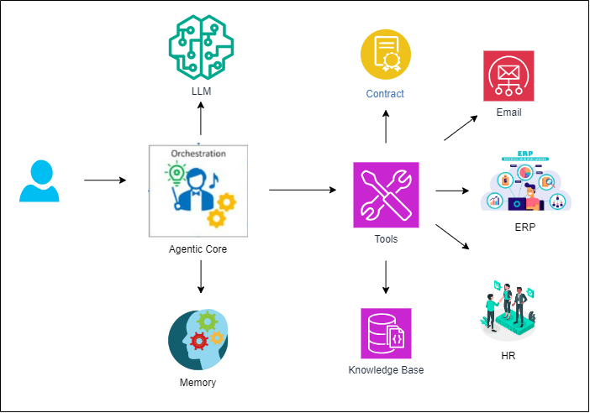


What is an AI Agent…
and how does it help…
Ethics, Transparency & Security
A software component that automates human functions in business process and workflows utilizing Generative AI.
Agents log their intent for each transaction, enhancing transparency and traceability. Safeguard agents monitor others to ensure compliance with responsible AI practices and ethical standards. Embedded security measures within agents provide a granular approach to security management
Key components
Agent Core
Central module defining agent’s behavior and coordinating with other modules.
Planning Module
LLM decomposing high-level tasks & reasoning to generate an execution plan. This plan gets executed by the agent.
Tools
Used to execute tasks (ex: API call or pipeline invocation etc.)
Memory Module
Stores logs of agent/user interaction and agent’s thoughts & actions
Flexibility & Scalability
Agent-based systems are modular, allowing for easier updates and maintenance. Each agent can be independently developed, deployed, and scaled without affecting the system. They also offer customizability and extensibility, enabling the addition or modification of agents with minimal disruption
Efficiency & Waste Reduction
Agents specialize in specific tasks, leading to efficient and optimized execution. They handle data locally, reducing transfer costs and improving performance. Additionally, agents optimize resource usage by adjusting operations based on current system states and workloads
Enhanced User Experience
Agents communicate using intent-based, natural language interactions, simplifying integration. They also interact with diverse systems and services, providing a unified interface for seamless integration across different platforms and technologies

Slide 5
Is AI Agent a new concept? The answer is No! Then why is it suddenly the talk of the town?

Slide 6

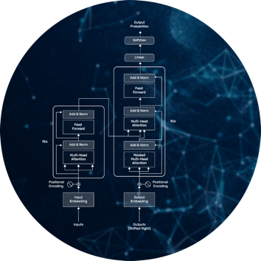





Evolution of Agent-based Systems: AI Has Come Full Circle
GENERATIVE AI
MULTI-AGENT SYSTEM
A new era of agent-based engineering has dawned upon us. But, like most breakthroughs, this one is also rooted in many years of research, and the reason the world is paying attention to it now is that, thanks to Generative AI and Large Language Models, we finally have artificial agents that are useful enough to scale to more serious problems.
AUTOMATION
DEEP LEARNING
DISTRIBUTED AI
Notes:
Include Automation instead of General Intelligence

Slide 7
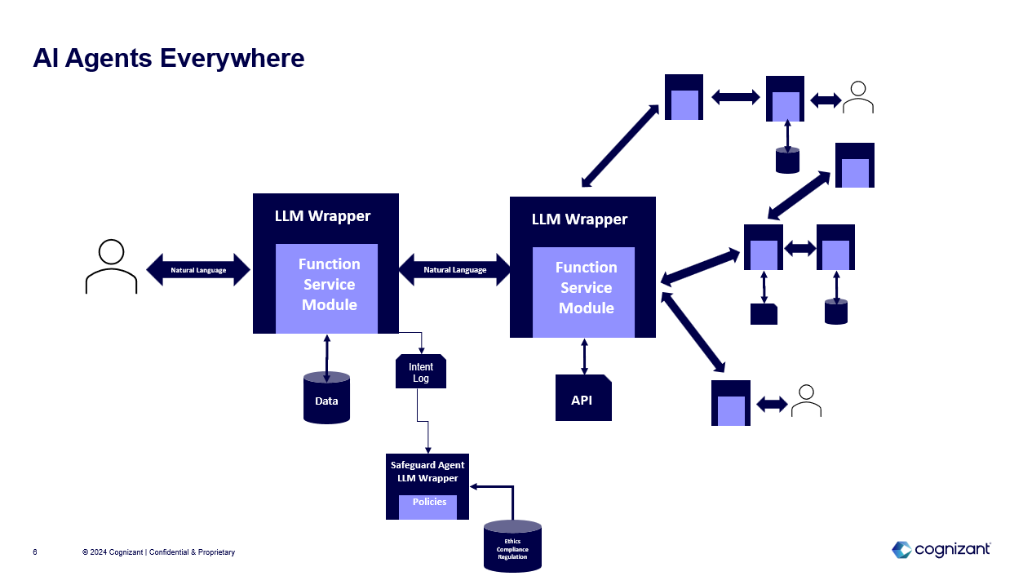

Agents are the Future: Gen AI has enabled creation of AI agents, and multi-agent systems for complex workflows
AI agent construct
Multi-agent construct
Multi-agent example
Developing and coding a new smartphone app…
AI Agent
LLM Wrapper
A real product manager gives instruction to an AI-agent product manager to design and develop a new app
Natural Language
Function
Service
Module
PM Agent then interacts with other agents, specialized in certain app development domains to create the app
Gen AI LLMs can understand language, reason, and plan (e.g., write code)
Using an LLM wrapper an LLM can interact with tools (e.g., external data sources, modules) acting as an AI agent
API
PM Agent
AI agents can be combined to complete large-scale, complex tasks
Agents interact with each other in Natural Language: Robust, future-proof, extensible
AI agents plan and perform tasks and communicate in natural language
Designing Agent
Coding Agent
Testing Agent
Documenting Agent
Notes:
Businesses are still scratching the surface when it comes to applying AI and Gen AI. The future is Agent–based.
LLMs understand language and can code/plan/reason.
Today, multiple LLM-based agents can work together to design and write code and, as a group of agents with distinct roles and responsibilities, they do better than a coding copilot.

Slide 8













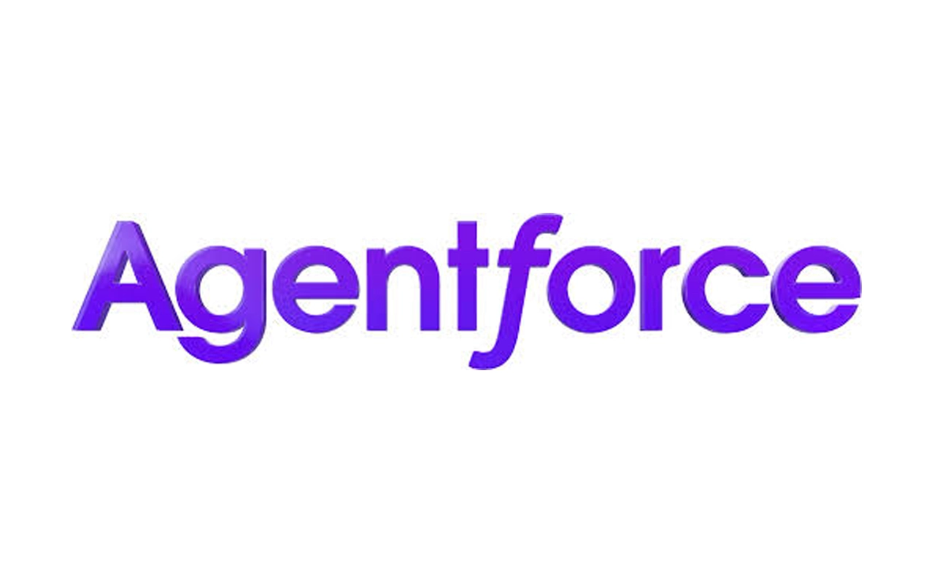
How are AI Agents different from traditional AI models?
Models – generate predictions based on inputs
Agents – do things
Memory
Tools
Other Agents
Text
Text
Images
Images
Users
Agent core
Action
Video
Video
Voice
Voice
Goals
Planning
Environment
Notes:
Businesses are still scratching the surface when it comes to applying AI and Gen AI. The future is Agent–based.
LLMs understand language and can code/plan/reason.
Today, multiple LLM-based agents can work together to design and write code and, as a group of agents with distinct roles and responsibilities, they do better than a coding copilot.

Slide 9
Gen AI systems have rapidly evolved from RAG to Agent-based approach in the past few months…
RAG (Retrieval-Augmented Generation)
Agent-based Approach
Pros
Pros
More factually accurate responses
Access to up-to-date information
Easier to maintain and update knowledge
Clear source attribution
Lower risk of hallucination
More predictable behavior
Efficient for information-heavy tasks
Lower computational costs
Can take actions and use tools
Complex reasoning capabilities
Dynamic interaction with environment
Can learn from experiences
Adaptable to new situations
Can combine multiple capabilities
Autonomous decision-making
Can generate novel solutions
Cons
Cons
9
Limited to retrieving existing knowledge
No complex reasoning capabilities
Cannot perform actions or use tools
Dependent on quality of knowledge base
May struggle with novel situations
Limited interaction capabilities
Cannot generate truly new insights
Higher computational overhead
More complex to implement & maintain
May make unexpected decisions
Requires careful safety constraints
Higher risk of hallucination
More difficult to debug
Needs clear scope boundaries
Human supervision may be needed

Slide 10
…with enterprises also looking to transition to Multi Agent Systems capable of executing multiple parallel tasks…
Single Agent Systems
Multi Agent Systems
Pros
Pros
Simpler to implement and debug
Clear chain of responsibility
Lower computational overhead
Easier to track and monitor
More predictable behavior
Streamlined decision-making
Lower infrastructure costs
Parallel task execution
Greater fault tolerance
Scalable architecture
Emergent problem-solving abilities
Can handle complex tasks through division
Specialized agent capabilities
More robust and resilient
Cons
Cons
10
Single point of failure
Limited by individual capability
No parallel processing
Can become overwhelmed by complex tasks
Lacks redundancy
Scaling issues with large workloads
May miss insights from multiple perspectives
Complex coordination required
Higher resource consumption
Communication overhead
Harder to debug and maintain
Less predictable behavior
More difficult to implement
Potential for conflicting goals

Slide 11







..however Multi-Agentic Systems come with their own challenges
LLM Jailbreaks – Privacy & Security
Task Termination
Challenges in enforcing granular access control unlike traditional systems and restricting access to sensitive information
Determining completion of task can be challenging and may lead to infinite loop
Maintaining Personality & Focus
De-stabilizing feedback loops
Agents flip roles as part of conversation
Agents repeating instructions of another agent
Harmful / negative feedback from one agent producing similar response and thereby resulting in a spiraling loop producing undesired / harmful outcomes
Effective Orchestration
Agents built on same Foundational models
Challenges in allowing agents to make autonomous decisions on selecting an agent to execute task and in what sequence. Do we impose constraint or provide autonomy?
Multiple agents built on same foundational model introduces challenges in addressing vulnerabilities particularly in large scale deployments from one agent producing similar response and thereby resulting in a spiraling loop producing undesired / harmful outcomes
Notes:
Businesses are still scratching the surface when it comes to applying AI and Gen AI. The future is Agent–based.
LLMs understand language and can code/plan/reason.
Today, multiple LLM-based agents can work together to design and write code and, as a group of agents with distinct roles and responsibilities, they do better than a coding copilot.

Slide 12
How do we make sure we realize the full potential of multi agent systems!

Slide 13
You need role-controlled Agents in a Multi-Agentic System
1
Admin Agent
Responsible to manage the communication between different agents and ensure that the original task supplied by the user has been accomplished to the fullest extent possible. This agent is configured to ask for user’s input at various points to ensure that user is onboard on the whole planning-reasoning-execute cycle, which is progressing between the agents. User can just hit enter, if he/she is satisfied with the progress. If not, user can type it out his/her response.
2
Planner Agent
Develops the overall multi-step plan of action and send it to the Critic Agent to have opinion about the suitability of the plan to the user’s given task.
Critic Agent
Ensures that the code written by Engineer meets the ethical, legal and all other standards of conciseness, clarity, and has precise comments in the code. In case of any external API call, ensured that the code has all the error handling in place and follows the best coding practices.
3
4
Engineer Agent
Writes any code needed to make any API call needed to receive the current data from internet or to save the output into a local machine’s folder.
5
Executor Agent
Run’s the code generated by the Engineer on the local server to ensure that it runs fine without any error.
6
Scientist Agent
Looks into the output generated by the successful execution of Engineer’s code and summarizes it according to user’s original request.

Slide 14

















Multi-Agent squads working on specialized activities across business areas
Industry Agents
Insurance
Banking and Financial Services
Healthcare
Life Sciences
Retail, Consumer Services, Travel & Hospitality
Manufacturing, Logistics, Energy & Utility
Communication
& Media
Plan Shopper
Audit Assist
Medical Report Analyzer
Opioid Abuse Detector
SDOH Identifier
Style Advisor Agent
Car Recommendation Agent
Video Analytics Agent
Claims Underwriting multi-agent system
Appeals & Grievances multi-agent system
Automated Flower Order multi-agent system
Contract Management multi-agent system
Guidelines Agent
Case Summarization Agent
Selection Agent
Amendment Agent
Risk Agent
Rates Agent
Decision Agent
Letter Generator
Cart Agent
Payment Agent
Review Agent
Compliance Agent
Business Domain Agents
General Purpose Enterprise Agents
Creative & Content Generation Agents
Developer Productivity Agents
Knowledge Assist Agent for Content Moderation
SQL Procedure Explainer
Customer Service Agents
Sales & Marketing Agents
HR & Recruitment Agents
Ticket Resolution Agent
Call Transcript Analyzer
Pitch Genie
Personalized Marketing
Interview Bot agent
Knowledge Management Agents
Data Processing & Analysis Agents
DOC OCR Parser
Letter Translator Agent
Synthetic Data Generator Agent
Metadata Extractor Agent
Data Quality Governance Agent
Financial Advisory Agents
Legal & Compliance Agents
IT & Cybersecurity Agents
Personalization & Recommendation Agents
Process Improvement Agents
Investor Relations
KYC Info Extractor
Product Catalog Agent
Style Advisor Agent
Idea Evaluator Agent
Certification Prep Agent
App Security
Incident Response
Representative multi-agent systems

Slide 15
Industry Agents

Slide 16
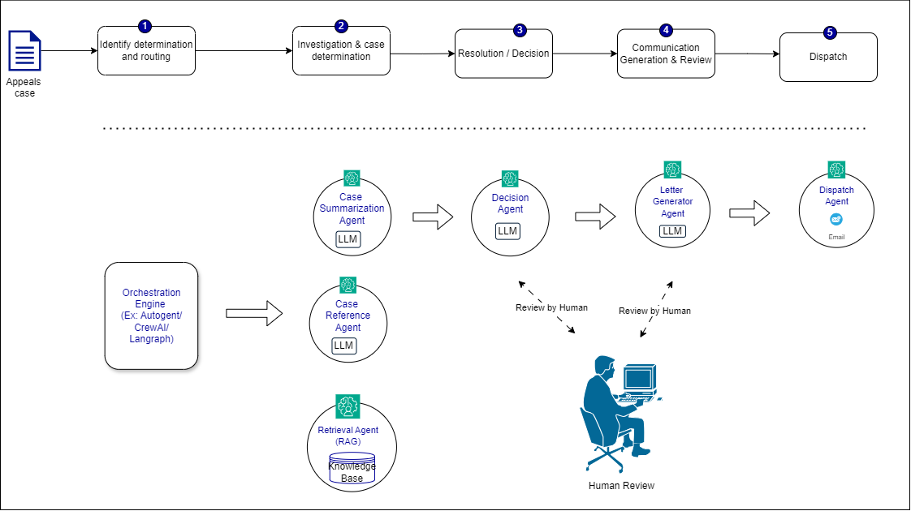
Agent based Appeals and Grievances Assistant for Healthcare
The agent-based Appeals and Grievances solution aims to streamline the resolution process for healthcare providers
Leveraging AI agents like case summarization agent, decision agent letter generator agent and dispatch, it enhances operational efficiency, reduces manual effort, and improves the accuracy and timeliness of resolutions.
This solution aims to reduce the time and effort required to review and process medical appeals by 20-25%, leading to higher productivity and cost savings for healthcare organizations and insurance companies.

Slide 17
Business Domain Agents

Slide 18
















Autonomous Agents for Financial Forecasting / Reporting for Consulting Services (Indicative)
Initial State
Next State
Final State
Agent-based solution for Financial Forecasts utilizes LLMs to automate the end-to-end process of Forecasting and Report generation enhancing the efficiency of running multiple complex scenarios in parallel, scaling the forecasting process across numerous variables and conditions.
The autonomous agents operate through a systematic approach involving thought, action, observation, and criticism, enabling them to handle heuristic and non-deterministic tasks.
The solution allows for the analysts to focus on strategic decisions, transforming the forecasting process into a faster, more accurate and highly adaptive system.
Identify Key Variables/Assumptions
Identify Key Variables
Identify Key Variables
Uploads Data to Agent
Uploads Data to Agent
Employ Data Modelling
Employ Data Modelling
Data Modelling
Create what-if Scenarios
Creating what-if Scenarios
Create what-if Scenarios
Simulate Forecast Outcomes
Simulate Forecast Outcomes
Evaluate & Interpret Result
Simulate Forecast Outcomes
Evaluate/Interpret Results
Generate Report
Evaluate and Interpret Results
Reviews Report
Iteratively Refine Results
Provides Feedback/Feeds New Data
Iteratively Refine Results
Generate Reports
Updated Reports with Evolving Market Conditions
Generate Reports
Financial Analyst
LLM Based Autonomous Agent
Simulating Agent

Slide 19
General Purpose Enterprise Agents

Slide 20

Research Helper - Multi-Agent Architecture
1
2
3
4
5
6
7
Admin Agent manages the task, selects the planner agent to create a plan
Planner Agents plans the steps needed to complete the task
Critic Agent analyzes the plan and approves if it is a solid plan
Engineer Agent develops all the scripts to access the needed data
Executer Agent runs all the scripts and retrieves the data
Scientist agent creates a concise summary for each paper
Admin agent ensures that all the parts of user’s task has been completed
User types a Research task
Planner Agent
Engineer Agent
Scientist
Agent
Executor
Agent
LLM
LLM
LLM
LLM
Orchestration Engine:
LangGraph,
Autogent,
CrewAI
Admin Agent
Critic
Agent
LLM
LLM
Human
Review and Finalization

Slide 21
Agent based systems – Building Blocks & Architecture

Slide 22
Multi-Agent AI System – Building Blocks
Agentic Workflow Engine
Agents Hub (Foundational)
Agents Hub (Use Case/Domain Specific)
Admin Agent
Planning Agent
Engineer Agent
Scientist Agent
RAG Agent
Analyst
Agent
Creative
Agent
Contract Analyzer
HR
Agent
Underwriter Agent
Execution
Agent
Critic Agent
SQL & DB Agent
Output -Response Agent
Governance Agent
Market Research
Supply Chain Agent
Customer
Agent
AR/AP Fin
Agent
Insurance Policy
Agent
Users /
Biz Apps
Agents Kernel
Memory
Tools Manager
Planning
Action
Guardrail
Controls
Execution & Scheduling
Short Term Memory
Profiling
Security
Optimize
Logging & Exceptions
Validation
Function Calling
Long Term Memory
Human
Feedback
Connectors, Integrations & Middleware
Database Connectors
Object Stores
Queues / Pub-Sub
Identity & Security Connectors
ERP 3rd Party Connectors
API Gateway, Mgmt.
Language Models Ecosystem
LLMs
SLMs
Domain Specific
Language Models

Slide 23
Generative AI @ Enterprise - Logical Building Blocks
Enterprise Subsystems (SAP, Salesforce, ServiceNow etc.)
User Persona
Productivity Tools
(Co-Pilots etc.)
Responsible AI
Operating Model
Biz Apps (Web/Mobile Apps, BI, Built in GenAI Apps, Conversational AI)
AI Agents
Agents Hub (Foundational)
Agents Hub (Domain/Use Case Specific)
Agents Kernel
API Management**
AI Gateway
Content Filter
Data Obfuscation
Prompt Injection Protection
Observability
Data Engineering &
Enterprise Knowledge Base
(Lake / Warehouse / VectorDB /
Document DB / Knowledge Graph)
Frameworks
AI & Gen AI Models & Services
Hallucination Check
Model Registration & Deployment
Containerization
Health Monitoring
Orchestration
Chunking & Vectorization
VectorDB Evaluation
RAG Validation
Agent Frameworks
Open-Source LLMs
First Party LLMs
Embedding Models
Adapt
Prompt Eng.
RAG
Fine Tuning
Contd Pretraining
RLHF: RLAIF
AI & ML
Services
Gen AIOps : LLMOps
Experiments: Evaluation : Testing: Deployment : Observability : Monitoring : Logging: Guardrails : Continuous Improvement
MLOps
DevSecOps, DataOps
Enterprise Infrastructure & Security

Slide 24
Future GenAI Agentic Platform Architecture
Provides a holistic view of capabilities and operating models to augment human intelligence required to automate business decisions in real-time through Agent-based systems
Personas / Actors
Recruiter
Risk Analyst
Developer
Underwriter
CXO
Reporting
External Systems
Core Solution
Business Functions
Agent Libraries
HR Assistants
Finance
Legal
Customer
Admin
R & D
Security
Marketing
Reporting
CrewAI
AutoGen
Langchain
Microservices
Domain X(Internal)
Domain Y(External)
Employee Agents
Data Agents
Code Agents
Composite
Agent Systems
3rd Party
Customer Agents
Creative Agents
CXO Agents
Composite Agent Systems
3rd Party
LangGraph
LlamaAgent
API Gateway
HTTP / HTTPS
gRPC / REST
JSON / XML / AJAX
TCP / IP
KAFKA
PROXY….
HTTP / HTTPS
GenAI, Agentic & Data Services
gRPC / REST
JSON / XML / AJAX
TCP / IP
KAFKA
PROXY….
Composite Services
Data Collection & Enrichment
Agent Patterns Inventory
Business Workflows
Composite Agent Systems
Agent Finetuning
Enterprise Agent Testing
Bedrock
Vertex AI
Azure AI
GenAI Agent-based Domain Services
Nvidia - Nemo
Fiddler, BentoML
IBM - WatsonX
Core Agent LLM Blueprints
Agent Tools
Agent Planning Templates
Agent Action Templates
Agent Action Patterns
Agent Memory Patterns
Agent Data and metadata management
Trace Collection, Processing, and learning
Agent Model Development
Self-organizing Patterns
Agent System Testing
Input/output Monitoring
System deployment and staging
Hallucinations, Safety, Bias, Explainability
PII Leakage, Realtime Protection
Performance monitoring
Regulatory Support & Executive Reports
Experiment Design Management
Platform Core Components and Cross Cutting Services
Microservices
Governance
Security
Event Driven
CI/CD
Process / Workflow Automation
Auto Scaling
Monitoring
Containerization
LLM/FM & DataOps
Evaluation
Resiliency

Slide 25
Agent based systems – End-to-End Execution Approach & Team Structure

Slide 26
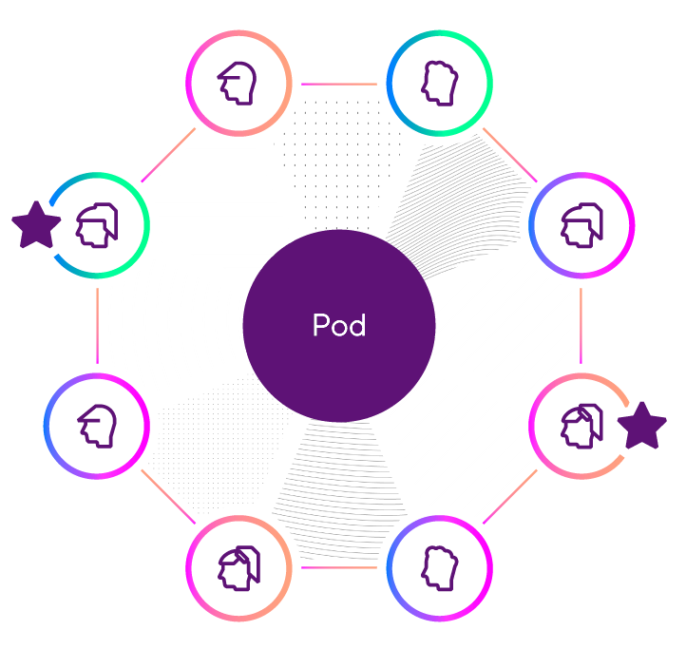
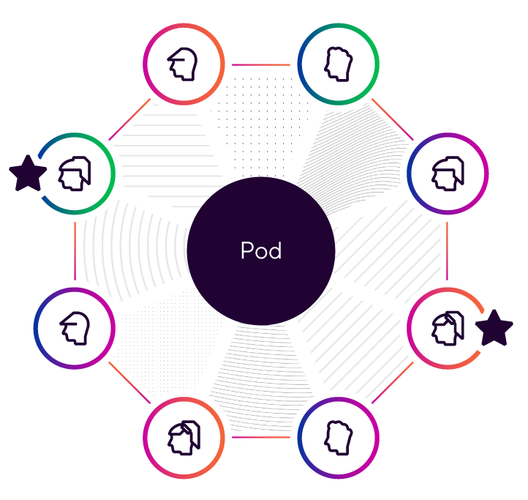

Indicative POD Structure
M1 – M12
M10 onwards…..
Start with 2 Foundation PODs / Hub Team
Spoke Teams added as required per needs/roadmap (representative)
Product Owner
Infra Architect
Principal AI Architect 1
Business User
Domain/OCM
Consultant 1
Foundation POD 1
AI Engineer
Spoke 1
Spoke 2
Data Engineer
AI Engineer
AI / LLMOps Engineer
Integration Engineer
Spoke 4
Spoke 3
Product Owner
Infra Architect
Principal AI Architect 1
Business User
Spoke Teams constructed with appropriate combination of skills to address near term, targeted execution needs. Foundation and New PODs can dynamically adjust staffing to handle some level of burst demand
Domain/OCM
Consultant 1
Foundation POD 2
AI Engineer
Data Engineer
AI Engineer
AI / LLMOps Engineer
Integration Engineer

Slide 27
Team Roles & Responsibilities
Role Name
Responsibilities
Role Name
Responsibilities
AI Engineer
Design, develop and deploy cutting-edge GenAI applications that integrate with existing systems and applications
Research and experiment multiple AI Agent prototypes to validate ideas with stakeholders
Seamlessly incorporate AI Agentic capabilities into existing or new applications to enhance user experiences and drive innovation
Continuously evaluate and improve the performance of AI Agents to ensure they meet desired accuracy, efficiency, and scalability standards
Collaborate with architects to define the overall architecture of generative AI solutions, ensuring scalability, performance, and maintainability
Keep abreast of the latest advancements in generative AI research and technology to identify opportunities for innovation and improvement
Engineering Manager
Provide overall strategic direction, guidance & oversight across program
Overall decision and escalation point to decide on the program’s most pressing issues and mitigate risks
Facilitate communications with client executive leadership
Review progress via dashboard metrics and reporting
Participate in reviews and define success criteria
Infuse best practices and industry experiences across program
Principal AI Architect
Design and develop cutting-edge multi-agent AI framework to make Agentic systems scale across the organization
Develop reference solution architecture for Agentic systems aligning with customers requirements
Collaborate with Product Owner/Domain Consultant/Business Users to analyze process flows & potential uses cases for AI Agents implementation
Design & develop multiple AI Agents that are inter-operable and scalable
Perform research and collaborate with hyper-scalers and product vendors on Agentic design patterns and product features
Publish design guidelines and industry best practices for Multi-Agent platform ecosystem
Review and extend existing Responsible AI practices to govern the AI Agents
Provide technical advisory and guidance to internal IT and Business teams related to AI Agents implementation
AI / LLMOps Engineer
Design, develop and deploy cutting-edge GenAI applications that integrate with existing systems and applications
Research and experiment multiple AI Agent prototypes to validate ideas with stakeholders
Seamlessly incorporate AI Agentic capabilities into existing or new applications to enhance user experiences and drive innovation
Continuously evaluate and improve the performance of AI Agents to ensure they meet desired accuracy, efficiency, and scalability standards
Collaborate with architects to define the overall architecture of generative AI solutions, ensuring scalability, performance, and maintainability
Keep abreast of the latest advancements in generative AI research and technology to identify opportunities for innovation and improvement
Design and implement LLMOps/GenAIOps processes to manage experimentation, deployment, monitoring, observability and continuous improvement
Build reusable frameworks to support automated integration, deployment, monitoring and alerts/notifications.
Domain Consultant
Maintain a well-managed backlog of requirements to train LLM Agents on specific high-priority use cases to perform business critical operations E2E. Documentation of project management plan, Milestone tracker.
Responsible for curating domain specific and focused training with customer's data so that LLM agents are well versed with industry specific language for better human-like customer interactions for customer facing roles.
Develop and train LLM agents with scripts for human interactions, continuously monitor and evaluate agent performances and provide feedback to ensure reliable and accurate results.
Support training agents in best security practices, advising how to handle sensitive human data and secure payment processing to maintain adherence to safe use of AI.
Integration Engineer
Designing and developing software components in Java Microservices Spring boot, Angular / React technology as per specifications
Reviewing the output from Gen AI tools / agents and identifying scope for improvement
Modifying existing software components for optimization, resiliency, enhancements and defect fixes
Troubleshooting and debugging existing programs and applications for resolution
Working closely with other IT stakeholders to coordinate software development and system changes
Ensuring all the established standards, guidelines and best practices are followed during software development; -Creating technical documentation
Assisting in architecture, design and implementation of software components in related technology; Providing technical support to end users
Data Engineer
Design, implement or maintain scalable data solutions that are aligned with AI program objectives
Develop and maintain a scalable data pipeline architecture that supports a wide variety of AI Agents data requirements
Collaborate with AI engineers and business stakeholders to define requirements for data transformations and knowledge base
Optimize data pipeline models for performance and scalability in a cloud-based environment

Slide 28
Agentic Frameworks
Framework | Key Feature | Remarks
Langchain | Opensource framework Versatile and Extensive Features Steep Learning curve High flexibility but increased complexity | Ideal if more control and advance features with customization are required
AutoGen | Opensource framework developed by Microsoft Studio – Low code to create and manage Agents for simple use cases Provides multiple conversational patterns Provides code generation and execution | Ideal if there is a need to build a separate framework to create and maintain reusable Agent library.
CrewAI | Opensource source built on top of Langchain framework Easy to learn and build Agents Can incorporate Langchain and LlamaIndex tools | Ideal for rapid PoC and want to reuse already existing langchain tools.
LangGraph | Extension of popular Langchain package Comparatively complex but provides greater flexibility and customization | Ideal if Langchain framework were already used. Suitable for complex workflows.
**Python, HuggingFace
Notes:
AutoGen

Slide 29
Summary
Humans + Agentic AI = Super Productivity
Future is collaborative, not competitive
Start small.. Build your first AI project this semester!
AI Tutor, Placement Bot, Research Buddy…
Notes:
AutoGen

Slide 30
Thank You!!!

Slide 31
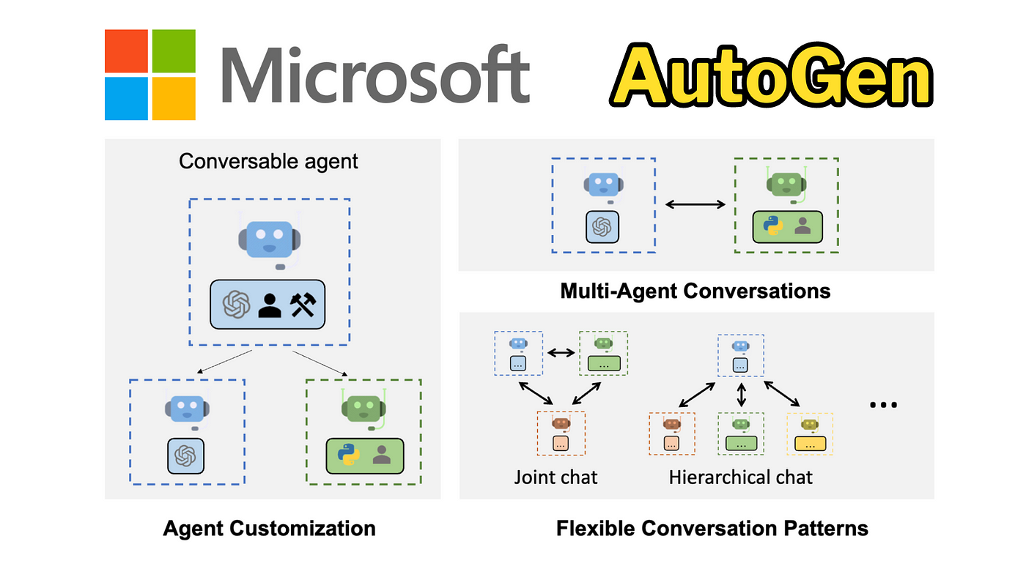
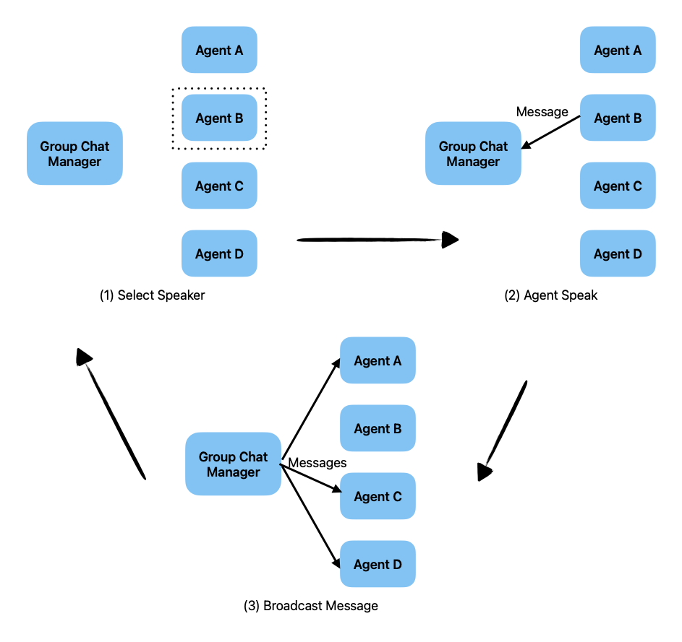
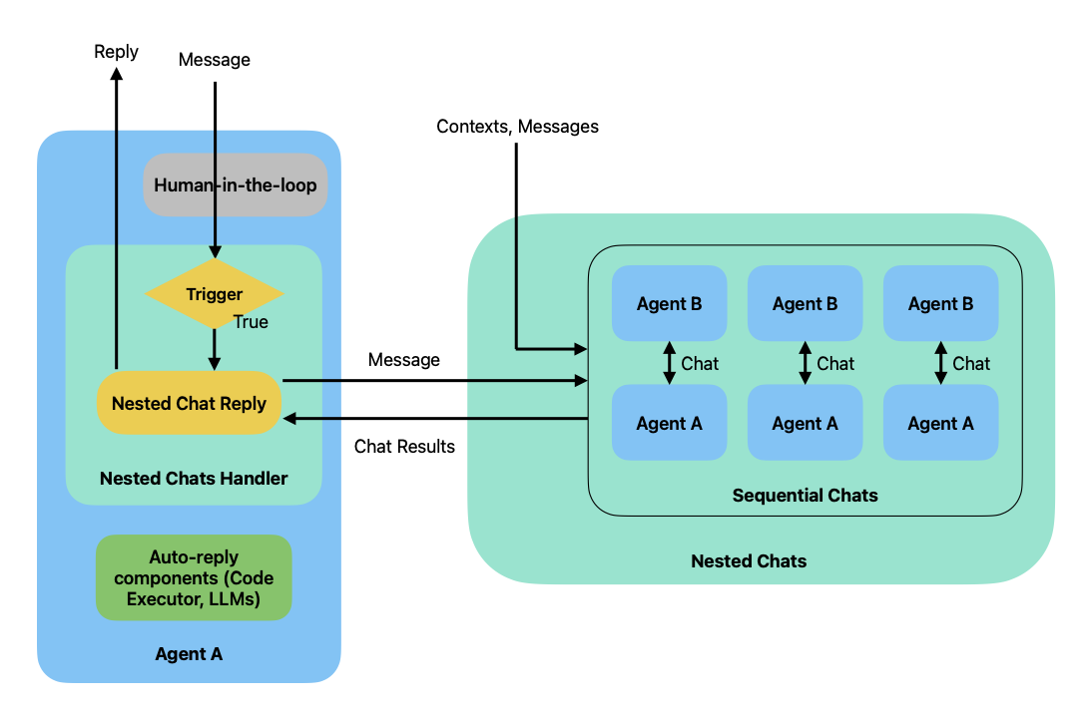
Multi-Agentic Framework
Group Chat Manager
Nested Chats

Slide 32
AI Agent and Multi-Agent systems for Research Help workflows
AI Agent construct
Multi-Agent construct
Multi-Agent example
User wants to research the key entities in Top5 publications in his/her area of interest
AI Agent
LLM Wrapper
A researcher gives instruction to an Admin AI-agent to find and generate doc for key entities in Top5 publications in his/her area of interest
Natural Language
Function
Service
Module
Admin Agent then interacts with other agents, specialized in creating and executing scripts to gather data from Top publications
Gen AI LLMs can understand language, reason, and plan (e.g., write code)
Using an LLM wrapper an LLM can interact with tools (e.g., external data sources, modules) acting as an AI agent
API
Admin Agent
AI agents can be combined to complete large-scale, complex tasks
Agents interact with each other in Natural Language: Robust, future-proof, extensible
AI agents plan and perform tasks and communicate in natural language
Planner Agent
Critic Agent
Scientist Agent
Executer Agent
Engineer Agent
Notes:
Businesses are still scratching the surface when it comes to applying AI and Gen AI. The future is Agent–based.
LLMs understand language and can code/plan/reason.
Today, multiple LLM-based agents can work together to design and write code and, as a group of agents with distinct roles and responsibilities, they do better than a coding copilot.

Slide 33
However Multi-Agentic Systems come with their own set of challenges
1
LLM Jailbreaks – Privacy & Security
Challenges in enforcing granular access control unlike traditional systems and restricting access to sensitive information
2
Maintaining Personality & Focus
Agents flip roles as part of conversation
Agents repeating instructions of another agent
3
Effective Orchestration
Challenges in allowing agents to make autonomous decisions on selecting an agent to execute task and in what sequence. Do we impose constraint or provide autonomy?
4
Task Termination
Determining completion of task can be challenging and may lead to infinite loop
5
De-stabilizing feedback loops
Harmful / negative feedback from one agent producing similar response and thereby resulting in a
spiraling loop producing undesired / harmful outcomes
6
Agents built on same Foundational models
Multiple agents built on same foundational model introduces challenges in addressing vulnerabilities particularly in large scale deployments from one agent producing similar response and thereby resulting in a spiraling loop producing undesired / harmful outcomes

Slide 34
Agentification is already happening! From Siloed Agents to multi-agent systems
Agentification refers to the use of AI agents to complete complex tasks & workflows by connecting individual systems and tools to one another, enabling users to interact with only one interface
Each agent handling all, or part of an inquiry asks its down-chains:
Are you responsible for all or part of this?
What will you need to handle your part?
If requirements surface, they are, sent to down-chains as inquiries first
The agent then delegates all or part of the inquiry along with any fulfilled requirements
Intranet Search Chatbot
IT
Security
Network Admin
Finance
Budgeting
Procurement
Legal
HR
Purchasing
Vendor Management
Contract Management
Compliance
Benefits
Payroll
Legal Advice
Accounting
Reporting
Contract Negotiations
Notes:
Agentification is happening naturally and incrementally.
Another example is “My significant other passed away” with the legal, payroll, and benefits agents responding.

Slide 35

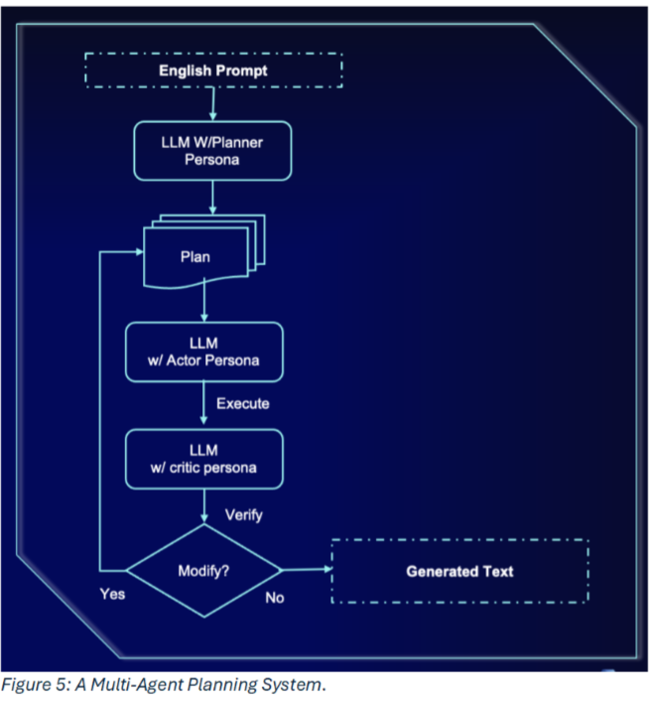

Balance Benefits & Challenges in a Multi-Agent Architecture Framework
Network of AI agents that interact to solve problems that are beyond individual agent capability or knowledge
Key Challenges
Additional Complexity and Overhead
Orchestrating agent interaction
Scalablity & Performance
Model security
Model Bias, Errors, Inconsistency, Halucination
Data and Privacy
Key Benefits
Automate repetitive task for increased efficiency
Higher quality outputs
Better customer experience
Adaptable to changing conditions
Enhanced decision making

Slide 36




Autonomous Agents for Investor Relations
Proposed Business Process Transformation for Customer’s Investor Relations process
Key Decisions taken while creating the Reports
Initial State
Next State
Final State
Sample
Based on the Earnings Release:
Which is the most impactful CEO quote?
Which financial metrics of the peer imply significant changes & trends?
What are the applicable business segments for the peer?
Based on the Analyst Reports:
Which three financial metrices of the peer have been highlighted repeatedly?
Which key reasons cited mostly as driving the peer’s out/under performance?
Which are the four most impactful analyst reports?
Based on the Financial Analysis Spreadsheet
Which financial metrics of the peer indicate most prominent improvement/ decline?
Based on the Earnings Call Transcripts:
Which factors drive questions from analysts in the earnings call?
Collects Documents
Collects Documents
Collects Documents
Uploads Documents to Agent
Uploads Documents to Agent
Reads Documents
Reads Documents
Reads Documents
Analyzes Documents
Analyzes Documents
Analyzes Documents
Takes Decisions
Takes Decisions
Self-Criticism & Adjustment
Self-Criticism & Adjustment
Takes Decisions
Writes Report
Writes Report
Writes Report
Reviews Report
Reviews Report
Provides Feedback
What are the parameters for self-criticism?
Self-Reviews Report
Updates Report
The Autonomous Agent takes these decisions based on its Natural Language understanding and interpretation abilities without any explicit coding!
Updates Report
Sends Email
Sends Email
Sends Email
Investor Relations Analyst
LLM Based Autonomous Agent

Slide 37
Agent based Appeals and Grievances Assistant for Healthcare
The agent-based Appeals and Grievances solution aims to streamline the resolution process for healthcare providers
Leveraging AI agents like case summarization agent, decision agent letter generator agent and dispatch, it enhances operational efficiency, reduces manual effort, and improves the accuracy and timeliness of resolutions.
This solution aims to reduce the time and effort required to review and process medical appeals by 20-25%, leading to higher productivity and cost savings for healthcare organizations and insurance companies.

Slide 38
Research Helper - Multi-Agent Architecture
1
2
3
4
5
6
7
Admin Agent manages the task, selects the planner agent to create a plan
Planner Agents plans the steps needed to complete the task
Critic Agent analyzes the plan and approves if it is a solid plan
Engineer Agent develops all the scripts to access the needed data
Executer Agent runs all the scripts and retrieves the data
Scientist agent creates a concise summary for each paper
Admin agent ensures that all the parts of user’s task has been completed
User types a Research task
Planner Agent
Engineer Agent
Scientist
Agent
Executor
Agent
LLM
LLM
LLM
LLM
Orchestration Engine:
LangGraph,
Autogent,
CrewAI
Admin Agent
Critic
Agent
LLM
LLM
Human
Review and Finalization

Slide 39
…and an AI Agents Catalog for specialized activities across Business Areas
A breakdown of the top 3 focus areas into business functions and their corresponding indicative list of agents (not an exhaustive list)
Requirements
User Story Agent
Software Development Lifecycle
Mapping Spec Agent
Coding
Data Profiling Agent
Testing
Coding Agent
Test Agent
Product offering
Market Research Agent
Prototyping Agent
Client Services
Customer Support
Virtual Assistant
Intelligent Advisor Agent
Fraud Analysis & Reporting
Fraud Analyst Agent
Campaign Design/Execution
Reporting Agent
Campaign Analyst Agent
Financial Forecasts and Reporting
Financial Analyst Agent
Consulting Services
Strategy Design
Simulation Agent
Note: This is a sample view, will be enhanced during the discovery phase.
Strategist Agent
ESG Assessment
Product Agent
Draft Proposals
Analyst Agent

